Slide 1
Inference with Mrs Keir
My inference
What I read in the text
What I know about the world

Slide 2
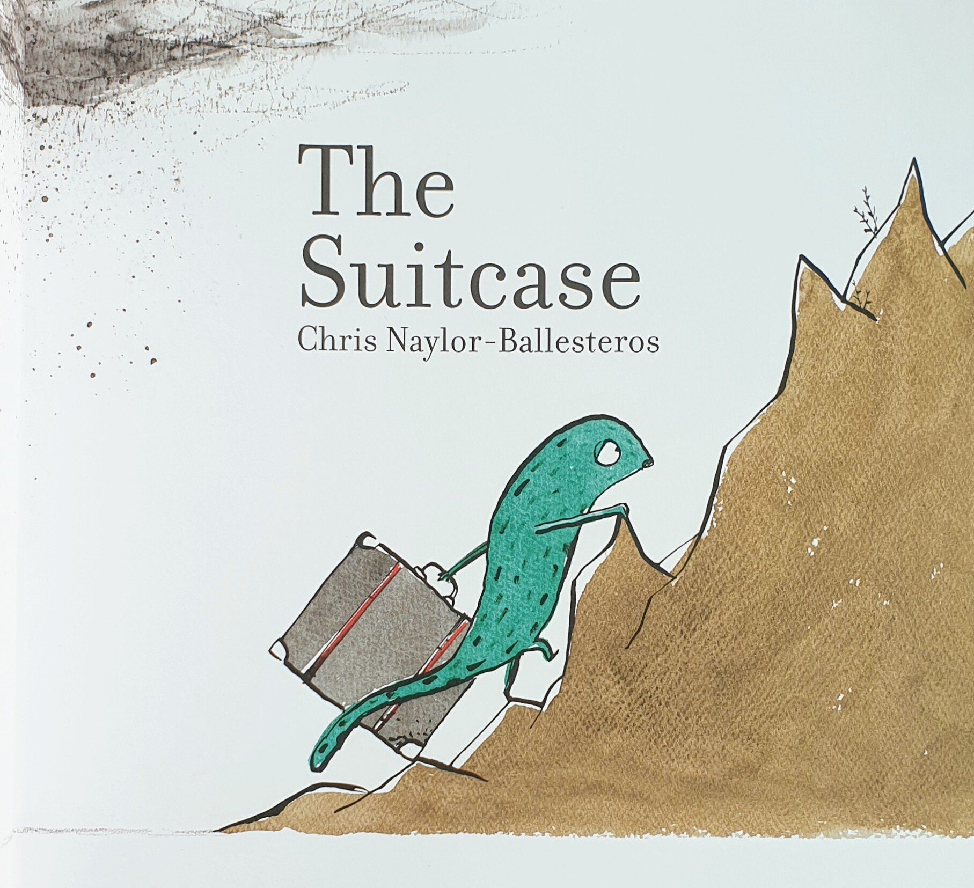

Slide 3

TALK PARTNERS
There are only 3 things in this suitcase.
What do you think they could be?
Be ready to explain your answer.

Slide 4


Slide 5
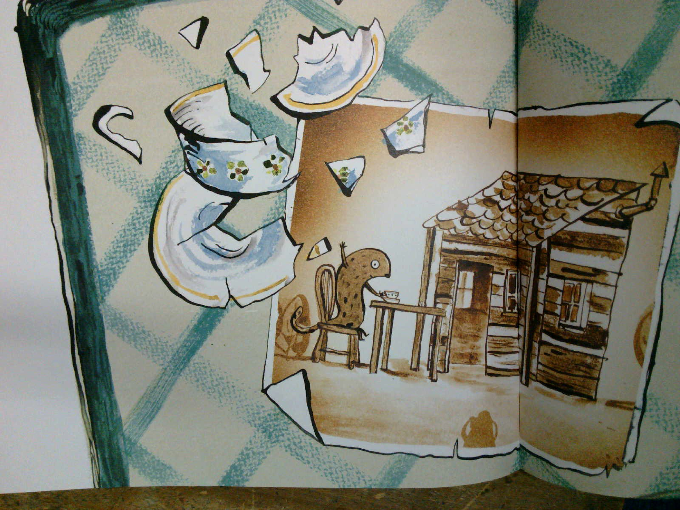

Slide 6
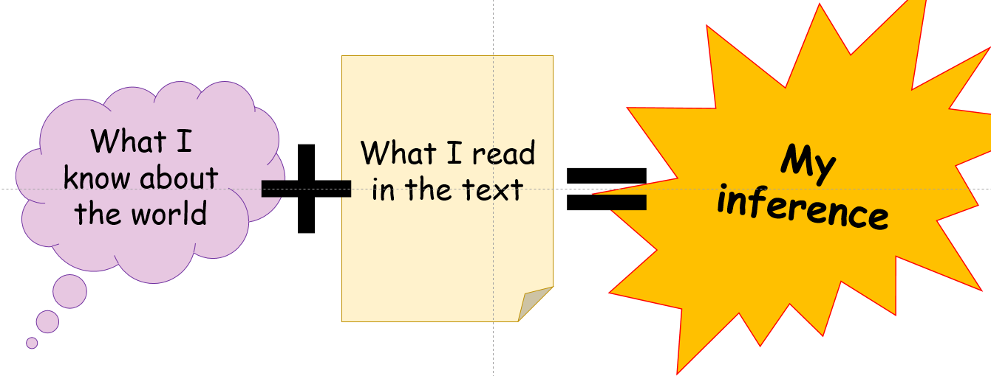
TALK PARTNERS
What could we infer about the creature based on these items?

